Slide 1

MACS30122 Final Group Project
University of Chicago
Portrait of Economic Academia:
Evidence from Top 20 Economics Journals from 2012 to 2022
Collaboration Network & Topic Modeling Analysis
Netrunners
Jerry Cheng
Hongzhang Xie
Yicheng Zhang

Slide 2
Table of Contents
1. Topic Overview
2. Research Questions and Social Science Relevance
3. Data Sources and Descriptions
4. Data Collection
5. Data Cleaning and Wrangling
6. Collaboration Network Analysis
7. Topic Modeling Analysis
8. Combining SNA and TM
9. Take-home Points

Slide 3
Data Description
Research topic:
Examine the characters of the economic research collaboration and topics
Question 1
What are the network features and collaboration patterns at the institutional and tier level? Density, centrality, cross-rank freedom?
Question 2
How research topics vary and evolve across time and institutions? For each topic, who are the most important contributors?
Question 3
Do centralities in the network research the same topics? For a centrality, who are parallel peers, who are distinct peers?

Slide 4
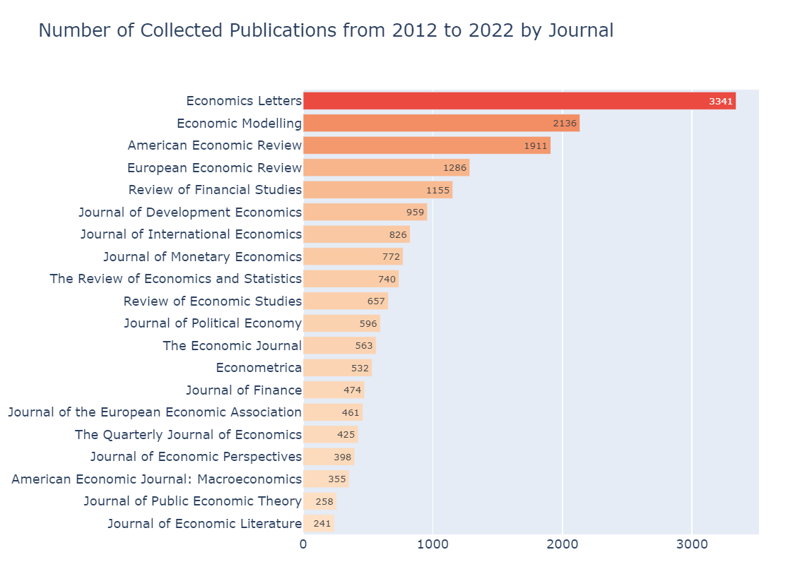
Data Description -Top 20 Economics Journals Data
We collected the data of top 20 economics journals ranked by h5-index (2017 – 2021).
Our raw data have 79,565 publications from 1886 till now.
We select 18,086 publications from 2012 to 2022 as the research sample.
We have three databases:
Top 20 Economics Journals Data
Google Scholar Author Data
Authors’ Affiliations Data

Slide 5
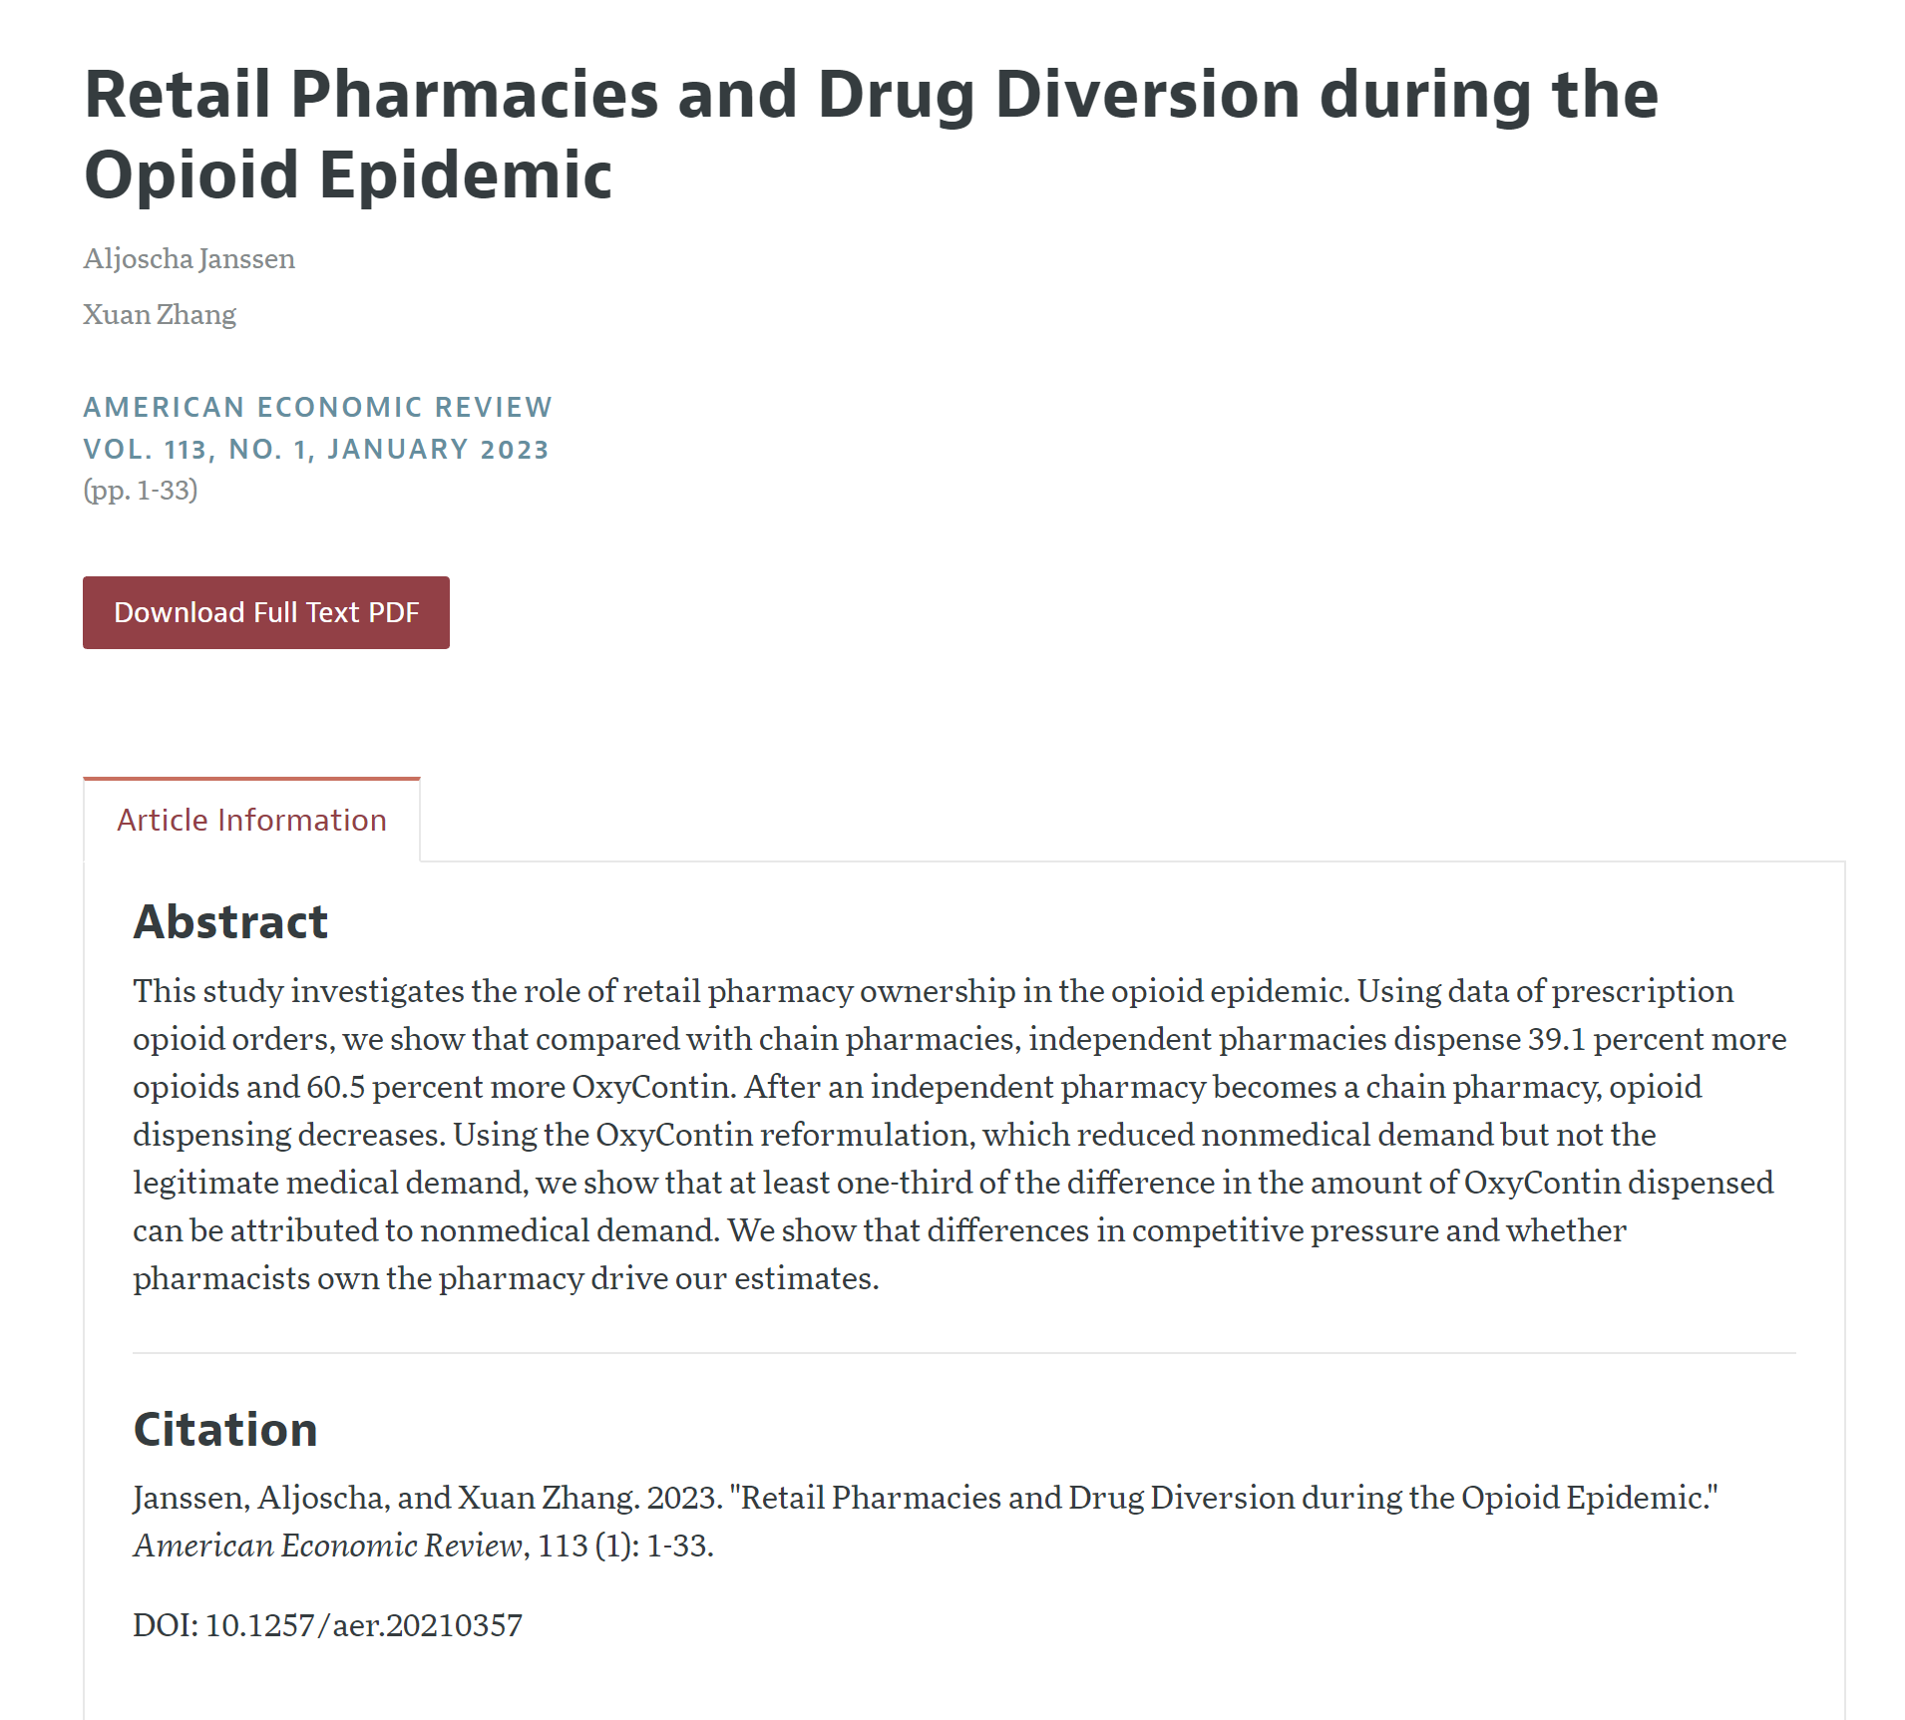
Data Description
Top 20 Economics Journals Data
Data sources
Title
Authors
Official Websites:
Journals
American Economic Association
Oxford Academic
Science Direct
VOL
Published time
Third-party database :
Abstract
ideas.repec.org
econpapers.repec.org
Citation
DOI

Slide 6
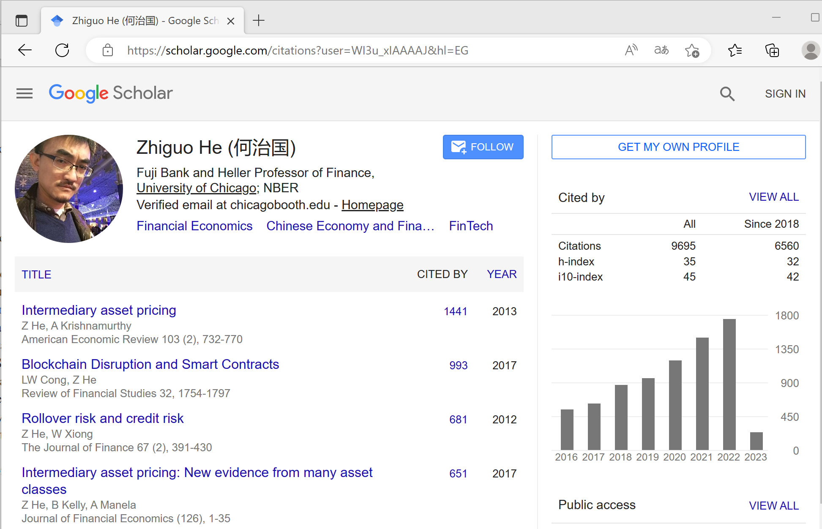
Data Description
Google Scholar Author Data
DOI
Links of two databases
Author id
We input the DOI in Top 20 Economics Journals Database to search the Authors of the publications in Google Scholar.
Name
Affiliation*
Data sources
Email
H-index
Google Scholar Author Database
Semantics Scholar Database
(For incompleteness data)
I10-index
Citations
* If the author has Multiple Affiliations, we use the Affiliation of the Email.

Slide 7
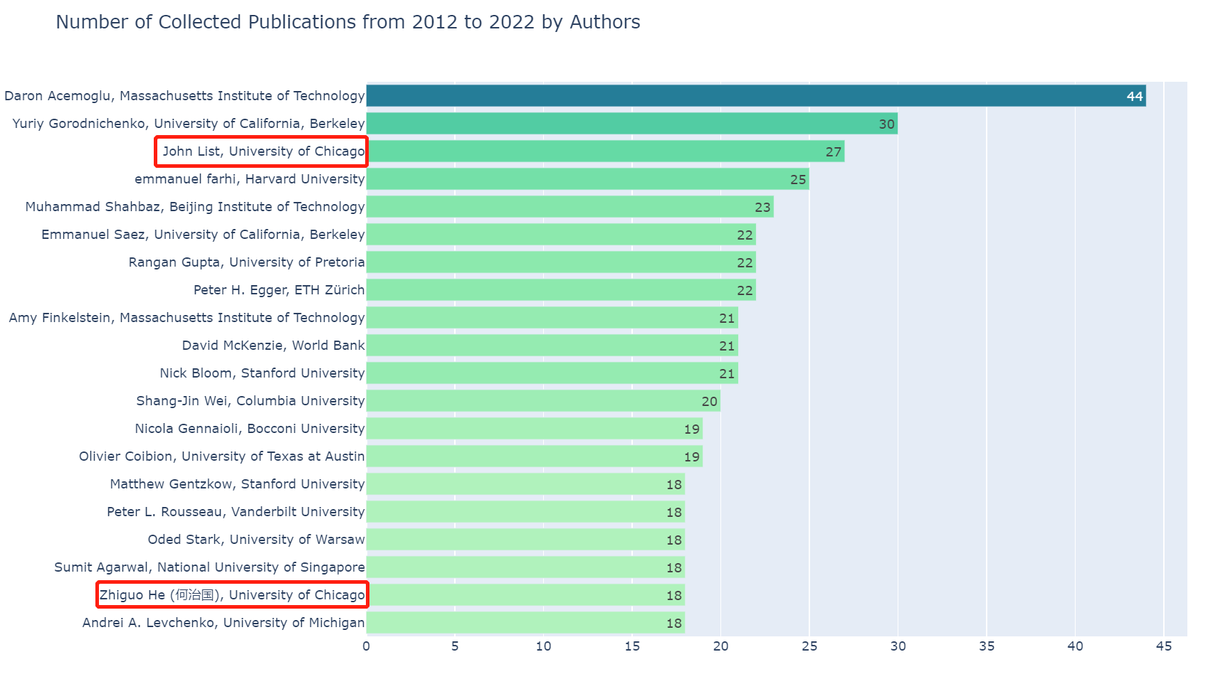
Data Description - Google Scholar Author Data
Our raw data have 19,585 records of authors
We select 13,654 authors who have publications from 2012 to 2022 as the research sample.

Slide 8
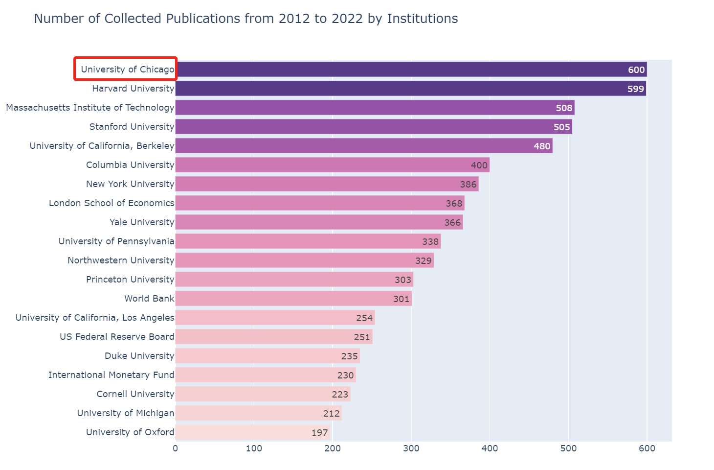
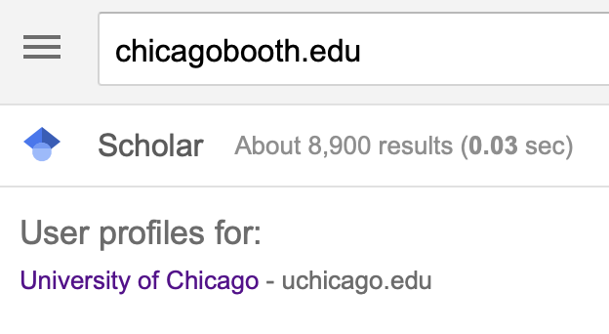
Data Sources and Description - Authors’ Affiliations Data
Data sources
Google Scholar Institutions Information
Data description:
Our raw data have 1,392 records of institutions.
We select 1,329 institutions that have authors who publish Top articles from 2012 to 2022 as the research sample.

Slide 9
Advantages
Large sample size with
multiple attributes.
High data quality,
Crawl data from authoritative databases
Importance, analyzing those data can help us better understanding the research collaboration mechanisms, and improve efficiency.
Innovation, few studies have used similar data sources.
Limitations
We do not analyze the publication information outside the top 20 economic journals.
There are still some missing data in Publish time, DOI, and Authors in the publications before 2000.
We did not crawl the data for the authors who do not have Google Scholar profiles.

Slide 10
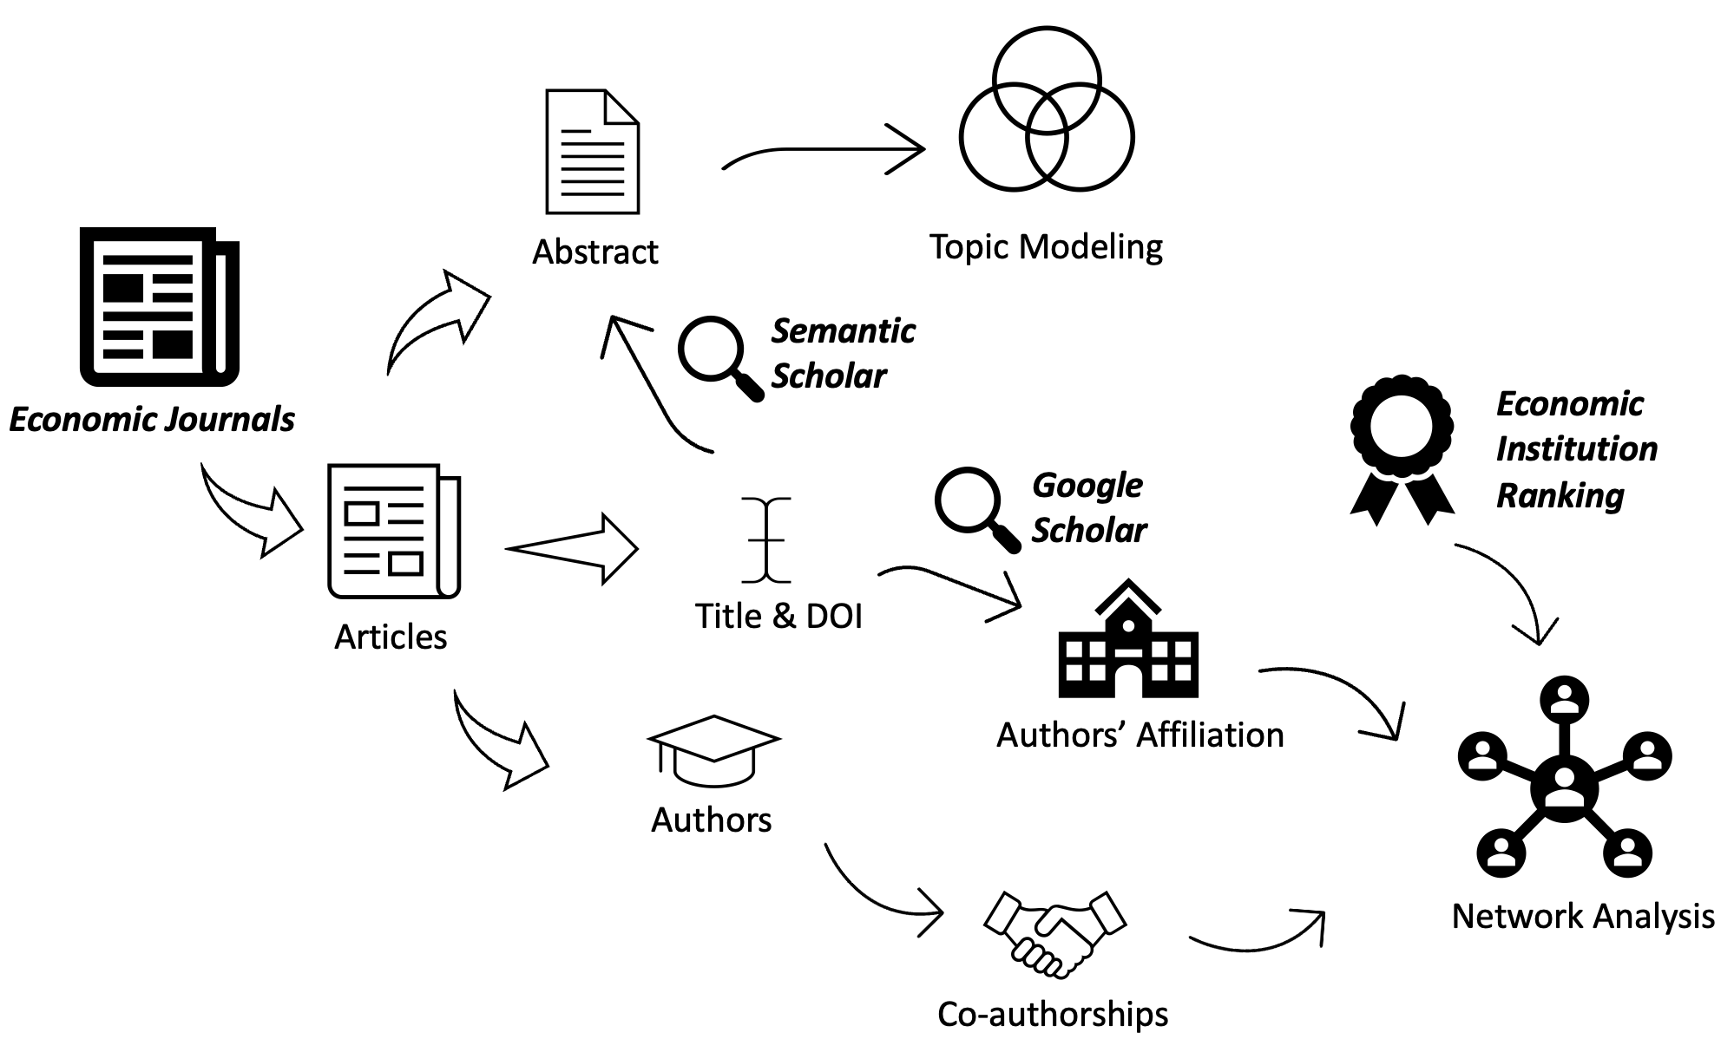
Data Collection Roadmap

Slide 11
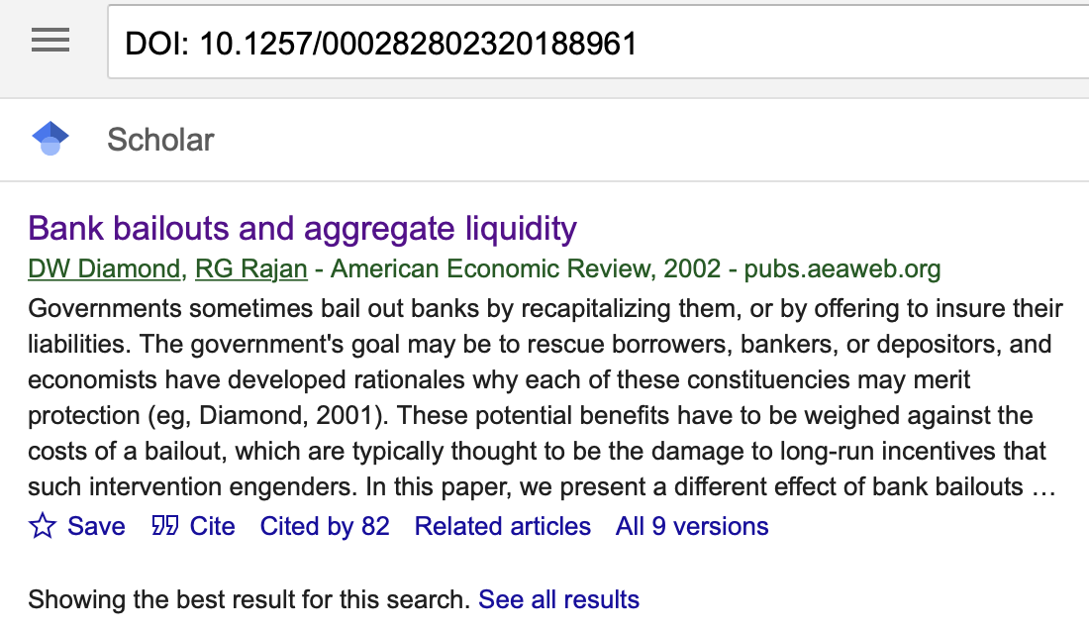
Building Authors Database
(1) Retrieve Authors’ Google Scholar Page
Iterate through the article database. For every article, search the article’s DOI (if available) in Google Scholar.
Since the DOI is unique for every article, the researching result is either one or none.
Scholars that has their own Google Scholar page will have the links embedded in their names.
Collected all the embedded links to revisit later.

Slide 12
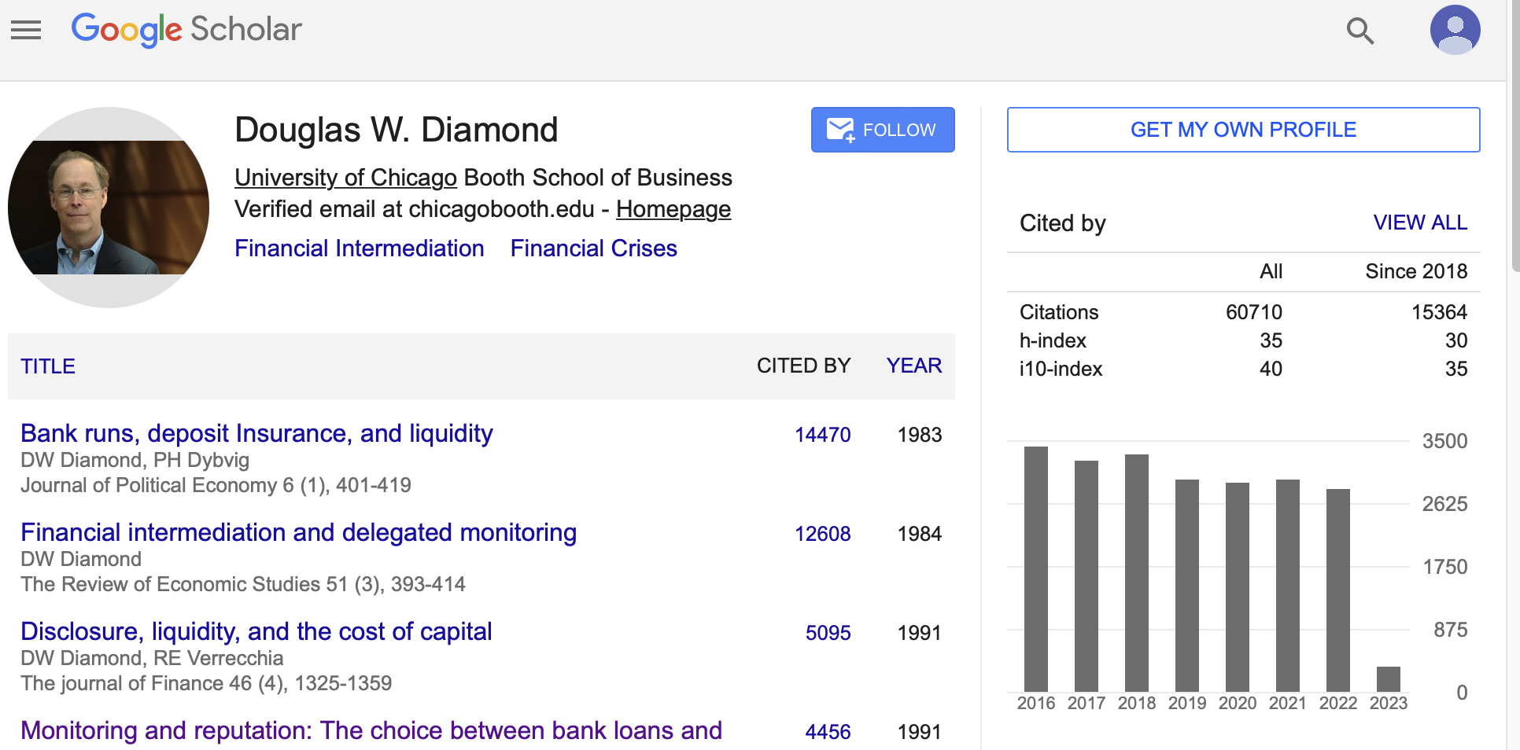
Building Authors Database
(2) Collect author’s info from Google Scholar page
Revisit the embedded URLs collected.
Collected information includes
the email address for this scholar.
(Google Scholar affiliation section is messy)
Citations by year
h-index and i10-index listed
Finally, search the email address collected directly in the Google Scholar.
The affiliation match with this address will appear in the top box.

Slide 13
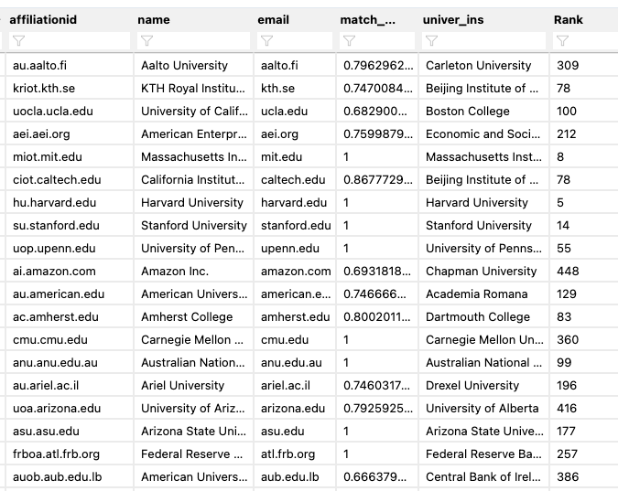
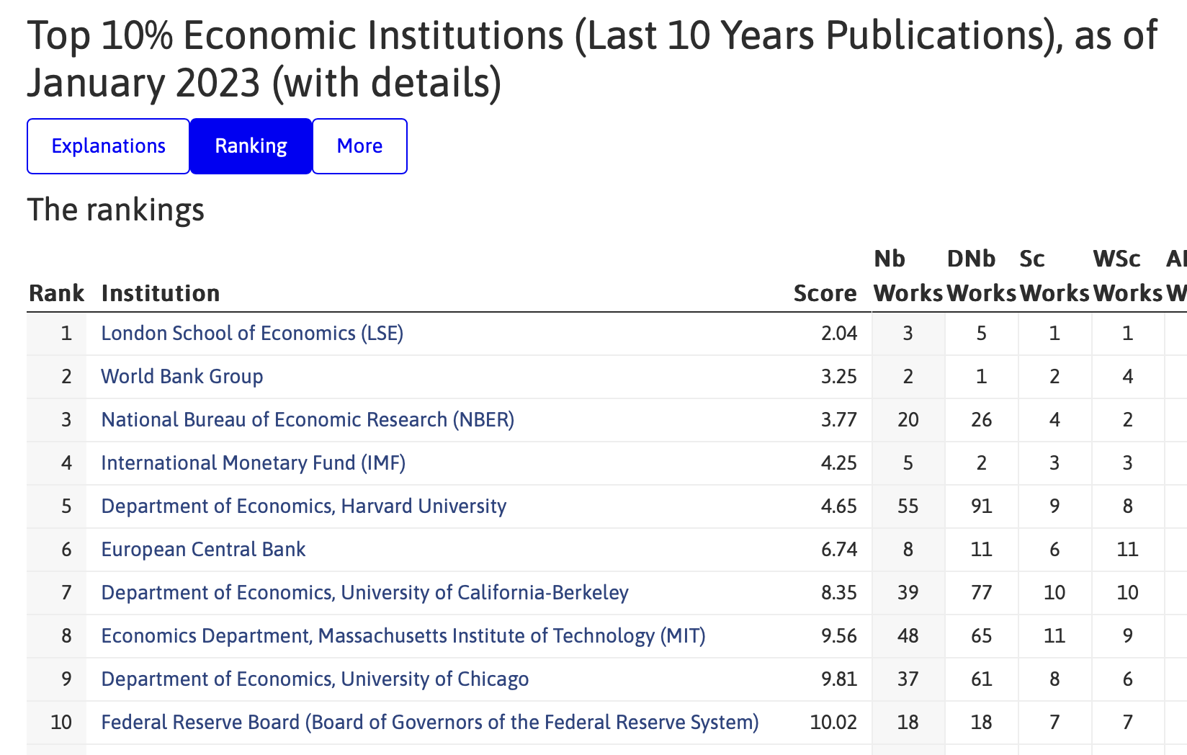
Building Institution Database
IDEAS ranking
Academic Oriented
Comprehensive ranking that include non-university institutions
Full record linkage
Common word is removed (“university of”)
Take the highest score
Exactly 200 institutions were matched

Slide 14
Database Outlook
Author
Author1 id
Email suffix
Affiliation id
Affiliation id
Institution1 Name
Ranking
…
Author-Article
Author1 id
DOI
Article
DOI
Abstract ...
Author
Author2 id
Email suffix
Affiliation id
Affiliation id
Institution2 Name
Ranking
…
Author-Article
Author2 id
DOI

Slide 15

Constructing Co-authorship links
Article – Author – Institution – Ranking
Author D from
UChicago (Rank 9)
LSE (Whole Dataset)
Author A from LSE (Rank 1)
Name | Number of links
LSE | 10
UChicago | 5
MIT | 5
Author C from MIT (Rank 8)
Author B from LSE (Rank 1)
(example)
Compile to Institution Level links
Notes:
We take the most straight forward approach and let every author to form an undirected co-authorship link with every other authors. So for an article with four authors, there will be six links. And since every author belongs to an institution, we eventually get an institution level link. We do the same thing for every article and compile author-level links to institution level links

Slide 16
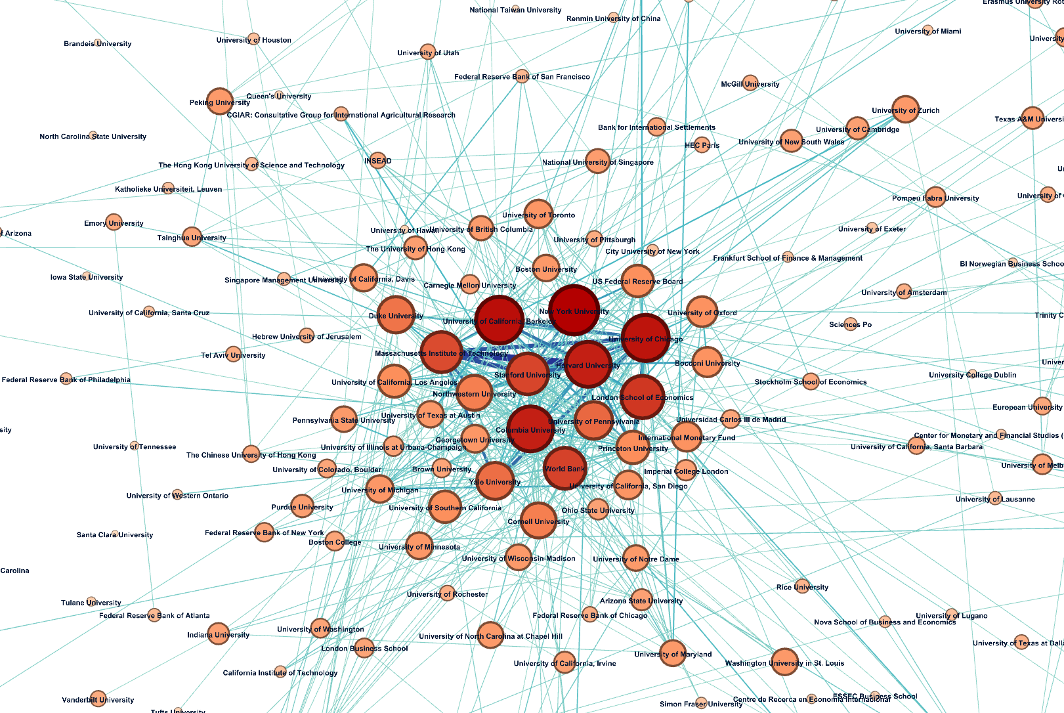

Slide 17
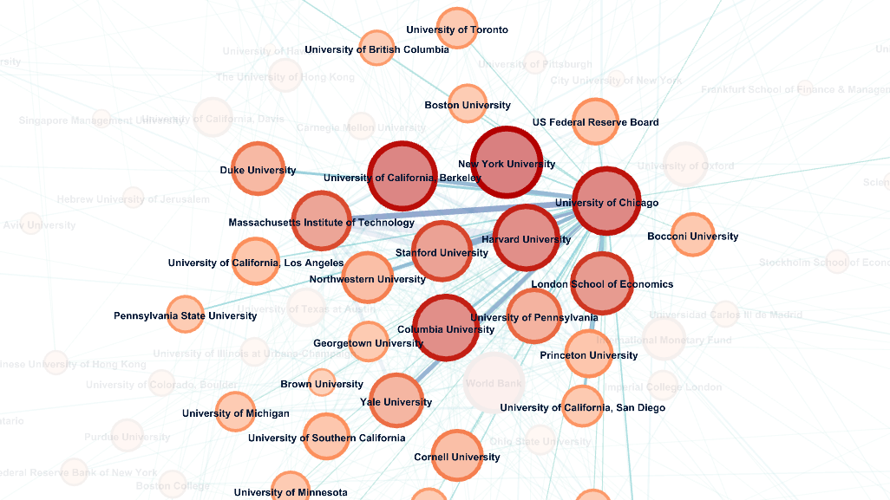

Slide 18
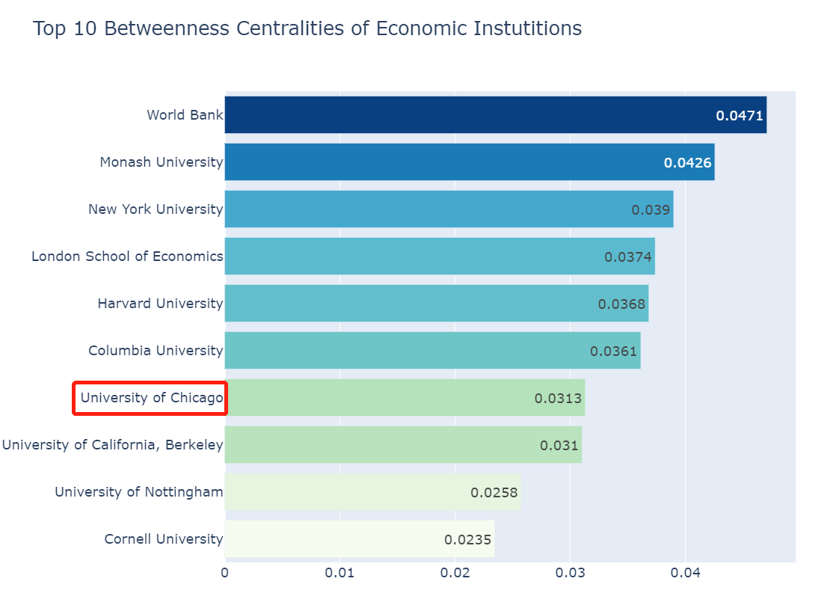
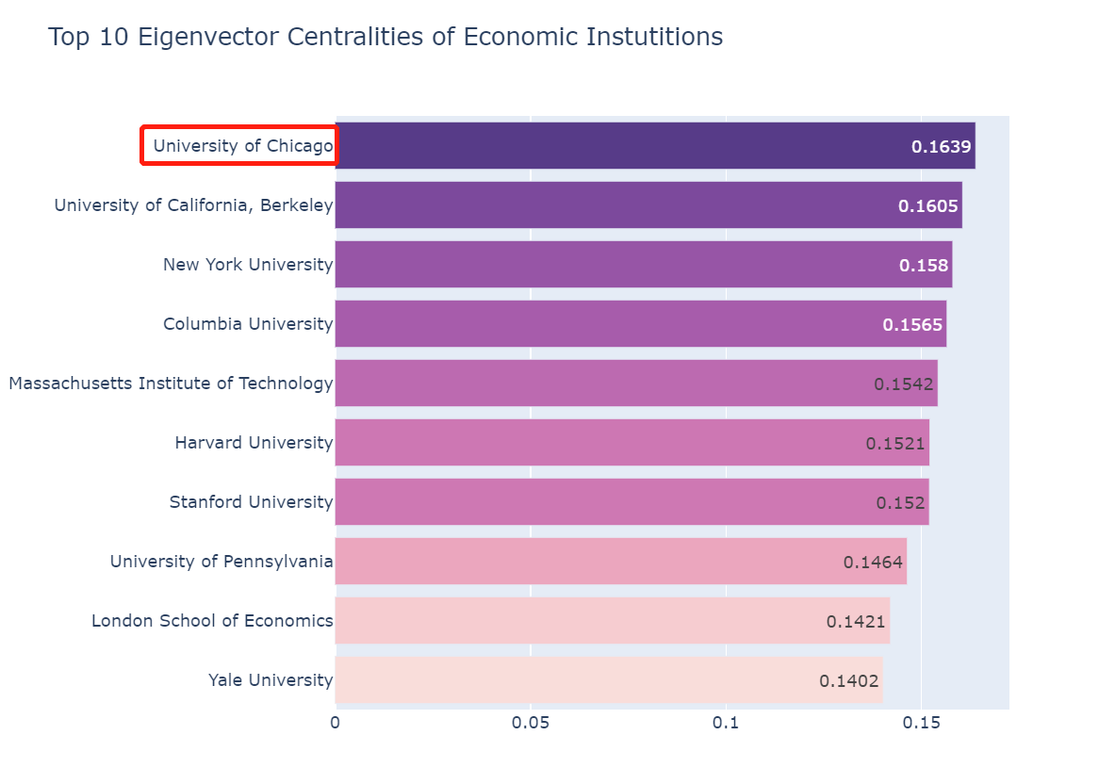
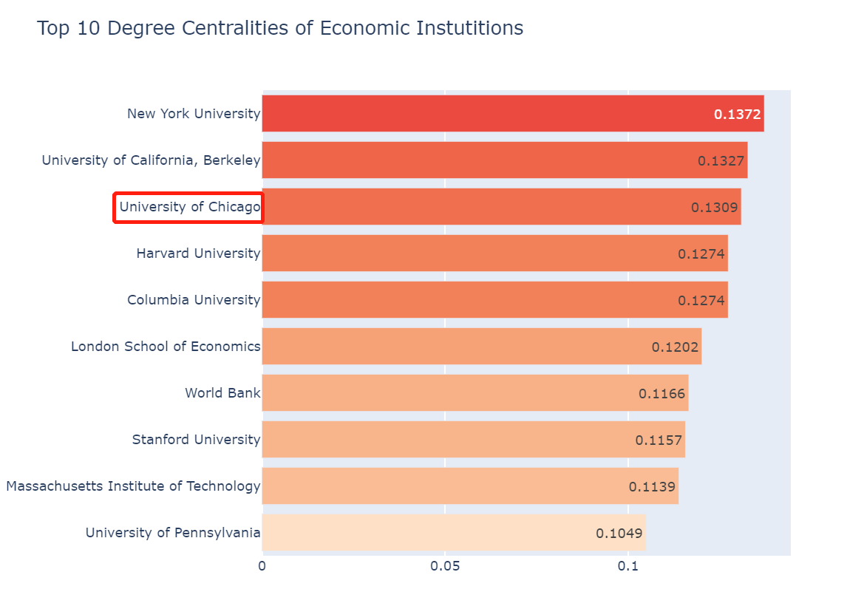
Centralities Analysis

Slide 19
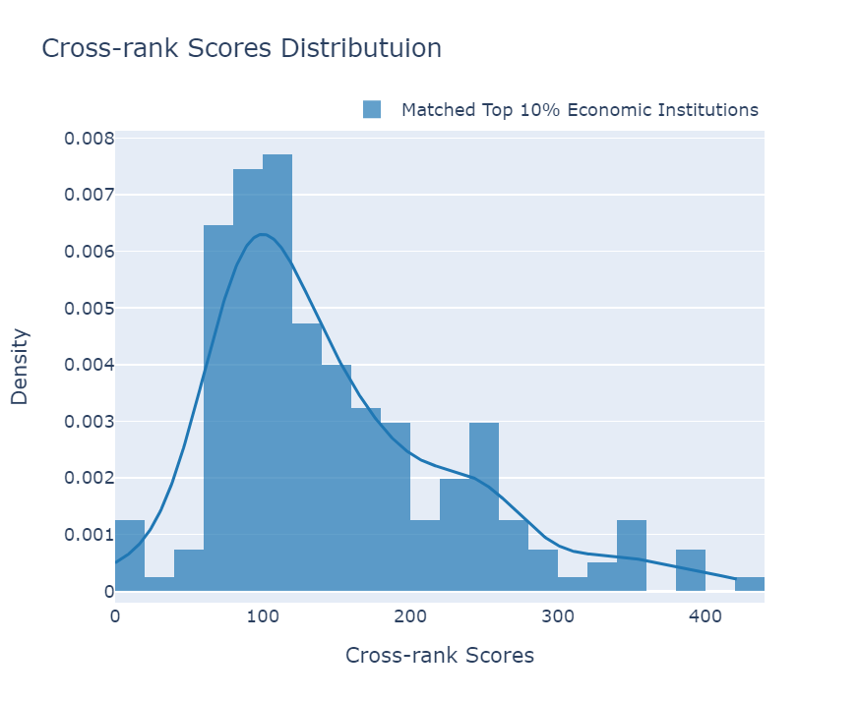
Quantifying Collaboration links
(1) Institution level analysis
LSE (Whole Dataset)
Name | Number of links | Contribution To the score
LSE (Rank 1) | 10 | 0
UChicago (Rank 9) | 5 | (9-1) * 5
MIT (Rank 8) | 5 | (8-1) * 5
(example)
Cross-rank score = (0 + (9-1) * 5 +(8-1) * 5) / 20 = 3.75

Slide 20
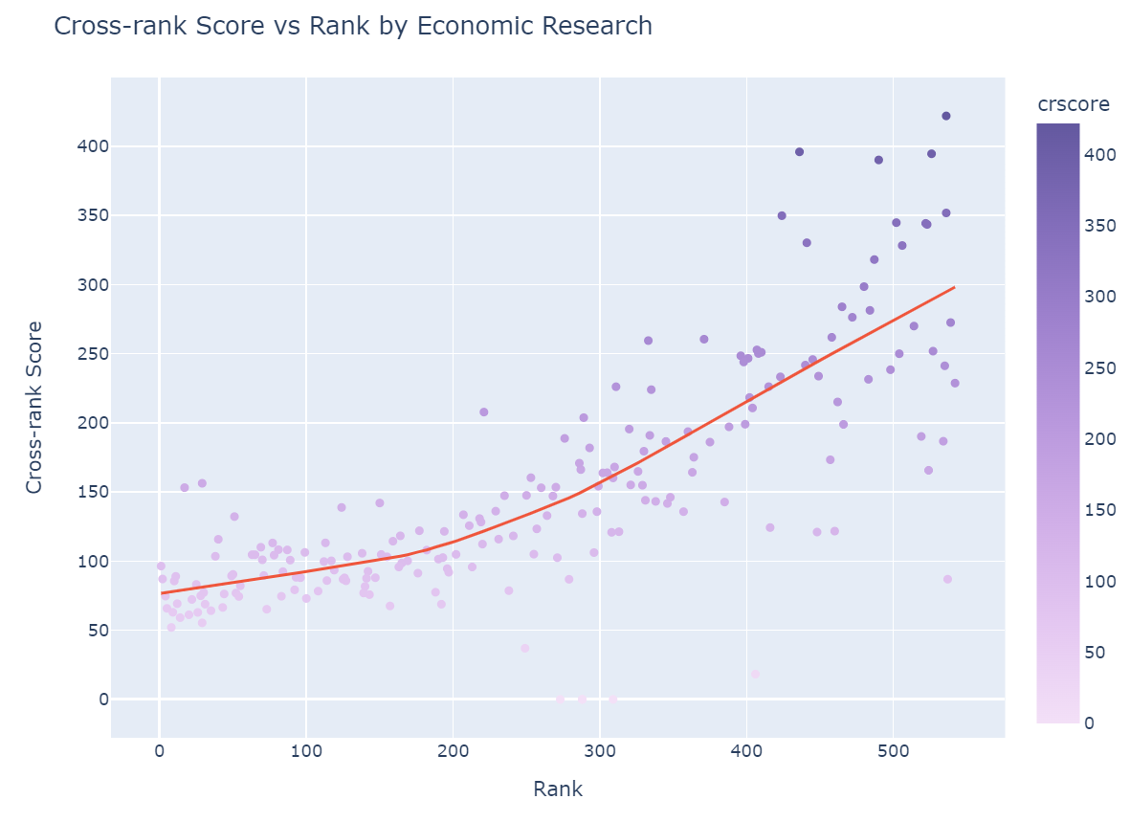
Quantifying Collaboration links
(1) Institution level analysis
Institutions that rank higher tend to collaborate more with each other - a low cross-rank score.
Cross-ranking collaboration is more common for institutions that rank later.

Slide 21
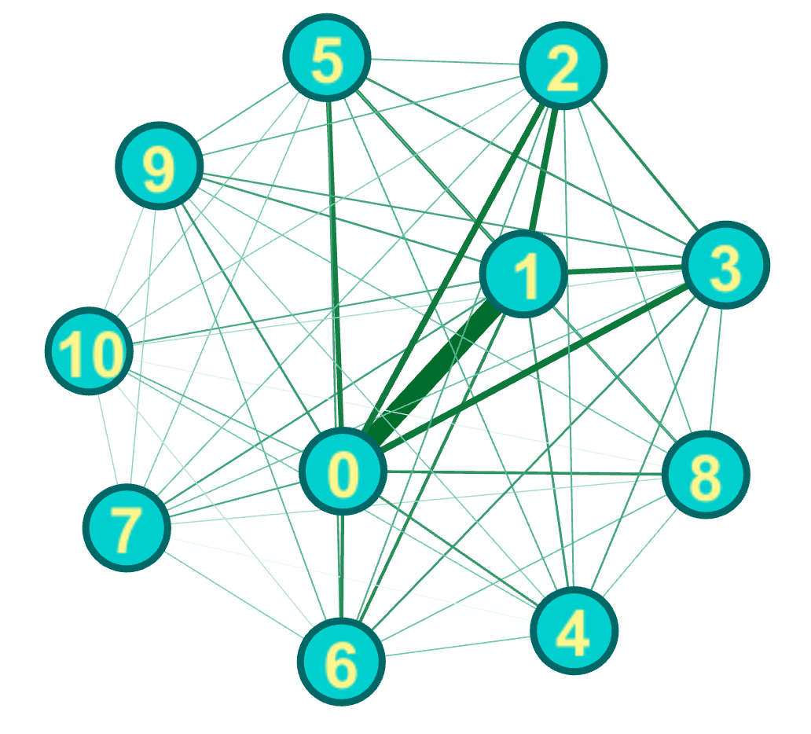
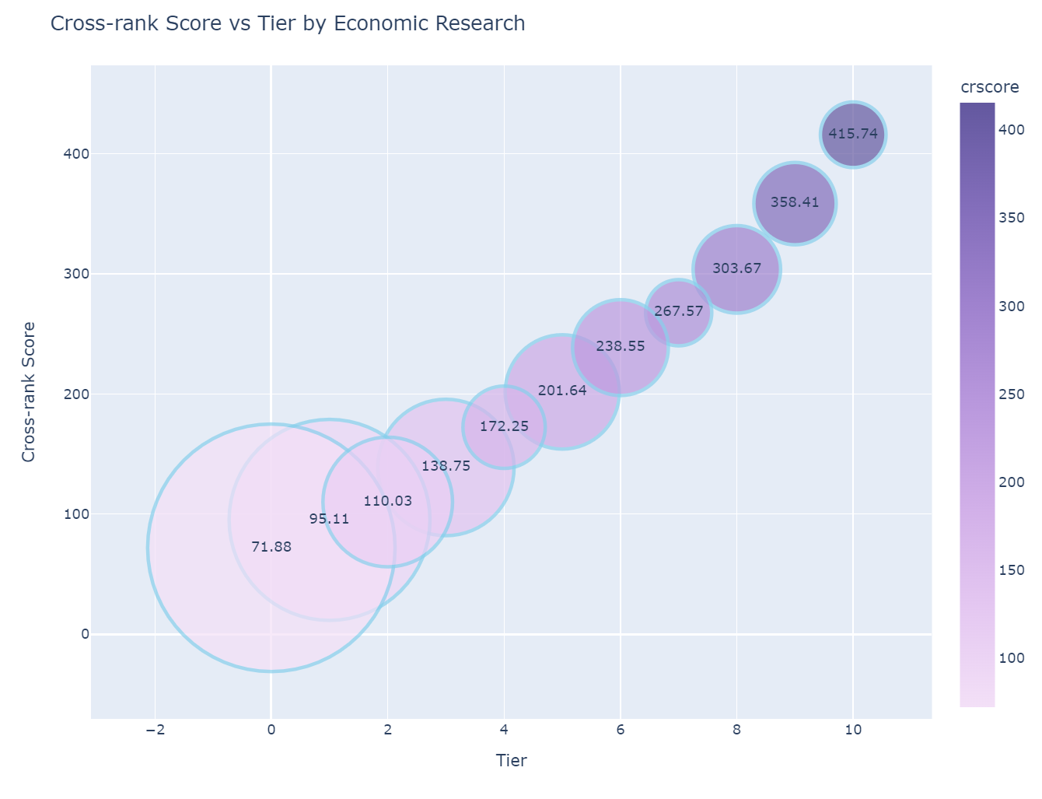
Quantifying Collaboration links
(2) Institution Tier level analysis

Slide 22
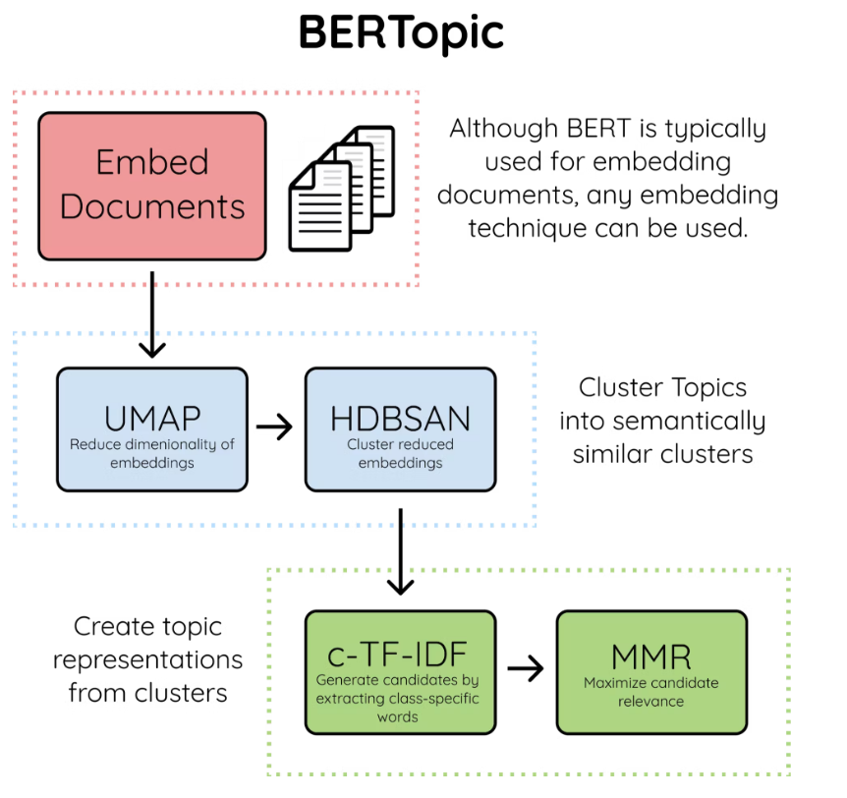
Topic Modeling Analysis
BERTopic Modeling
An emerging TM technique that uses language embedding and class-based TF-IDF
Original Paper (Grootendorst 2022): https://arxiv.org/abs/2203.05794
Documentation: https://maartengr.github.io/BERTopic/index.html
Advantages over LDA TM
Easy to fit in model: only need to clear stopwords and re-concatenate into paragraphs
Much more stable: results may vary a little across runs but not as much as LDA
Much less training time: 15,000+ abstracts take less than 1 minute to train
Source:https://hackernoon.com/nlp-tutorial-topic-modeling-in-python-with-bertopic-372w35l9
Notes:
Image Source: https://hackernoon.com/nlp-tutorial-topic-modeling-in-python-with-bertopic-372w35l9

Slide 23
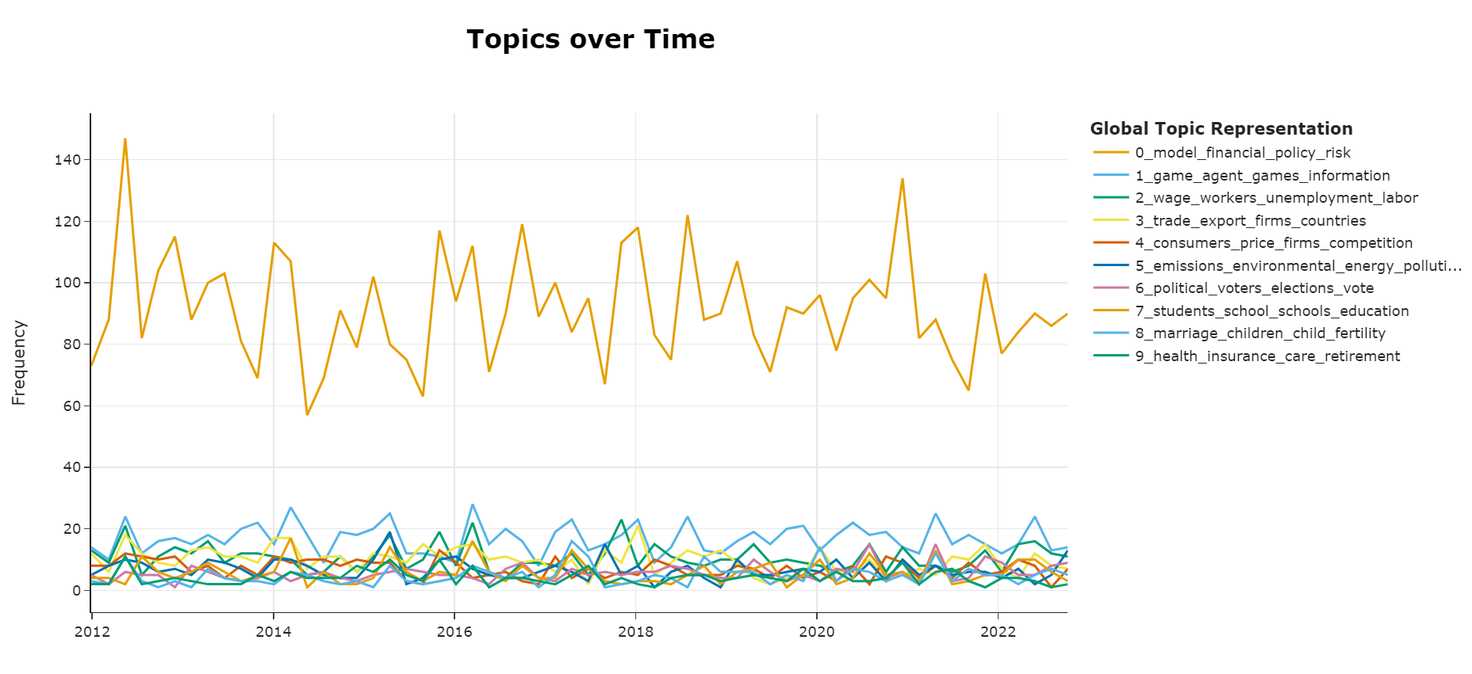
Topic Modeling Analysis
Dynamic Economic Research TM over Time
Dominating, but NON-trivial! Need further splitting among these documents for better results.

Slide 24
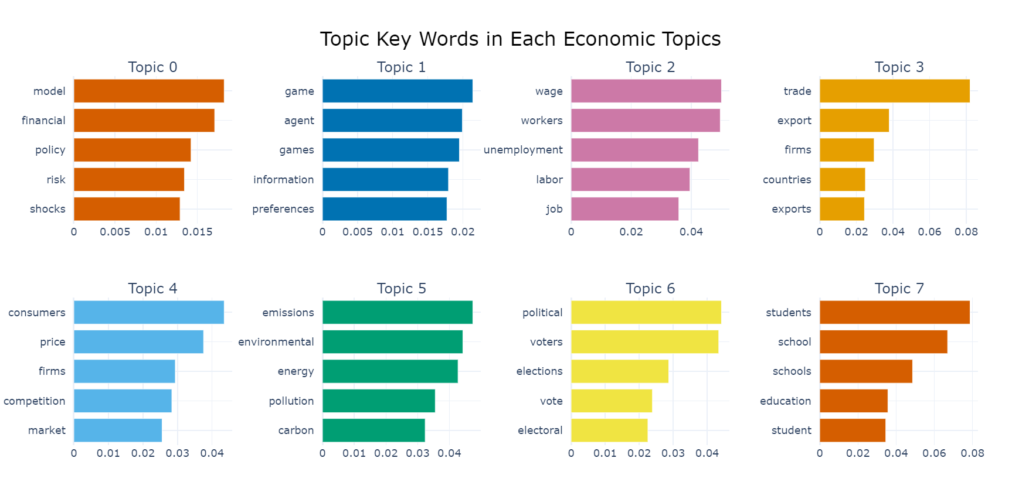
Topic Modeling Analysis
Top 5 Keywords for each Topic:
Notes:
May deal with the problem of plural form later!

Slide 25
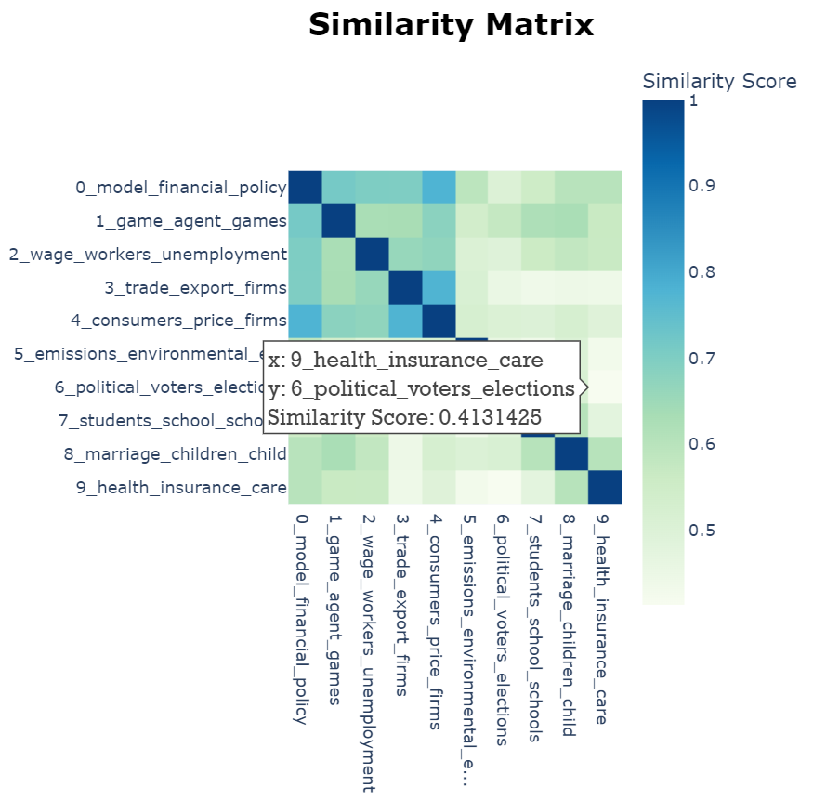
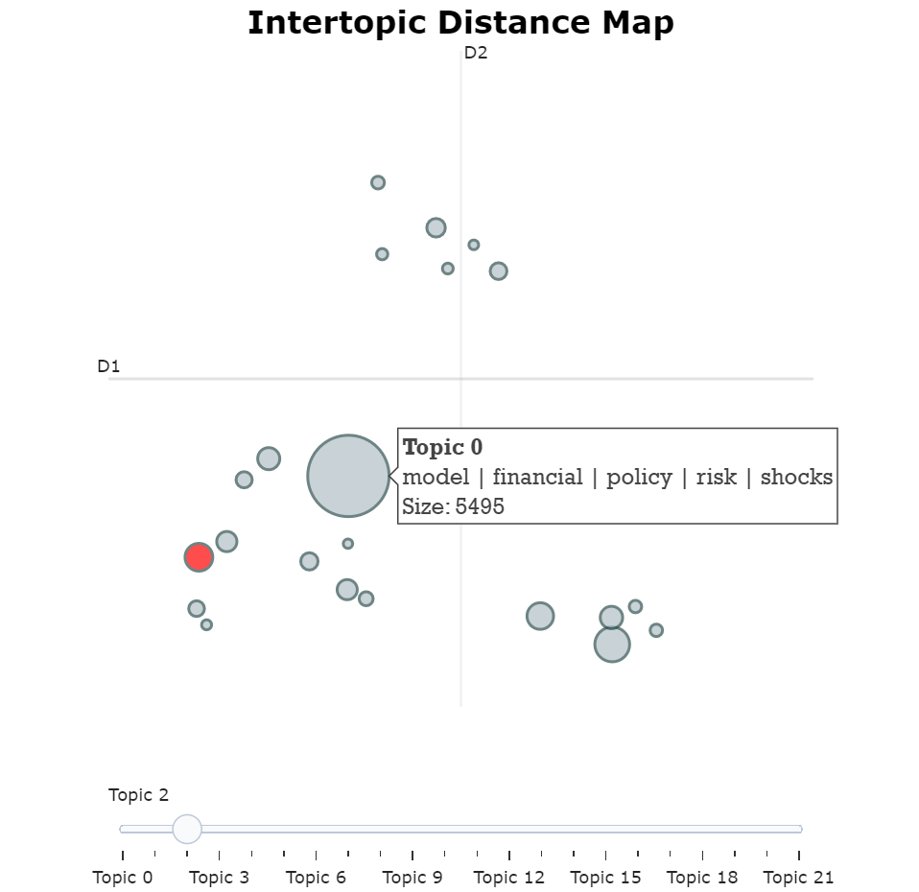
Topic Modeling Analysis
All topics do NOT overlap on Intertopic Distance Map, so the training result should be fine!
Similarity and Intertopic Distance

Slide 26
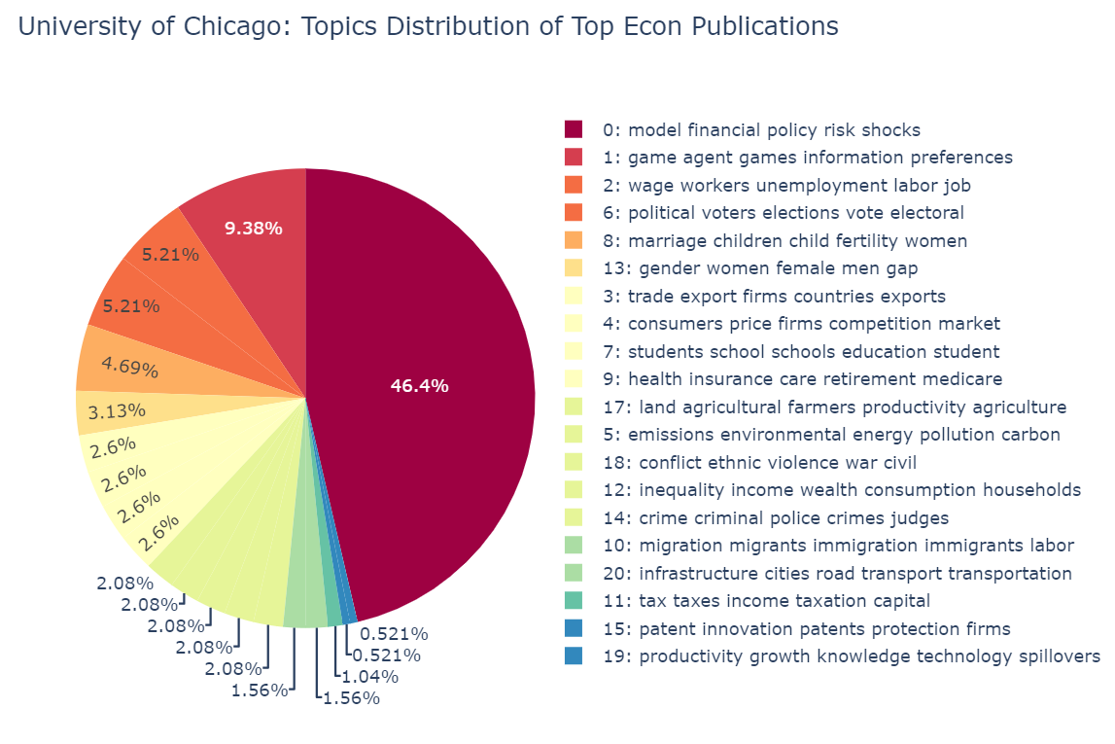
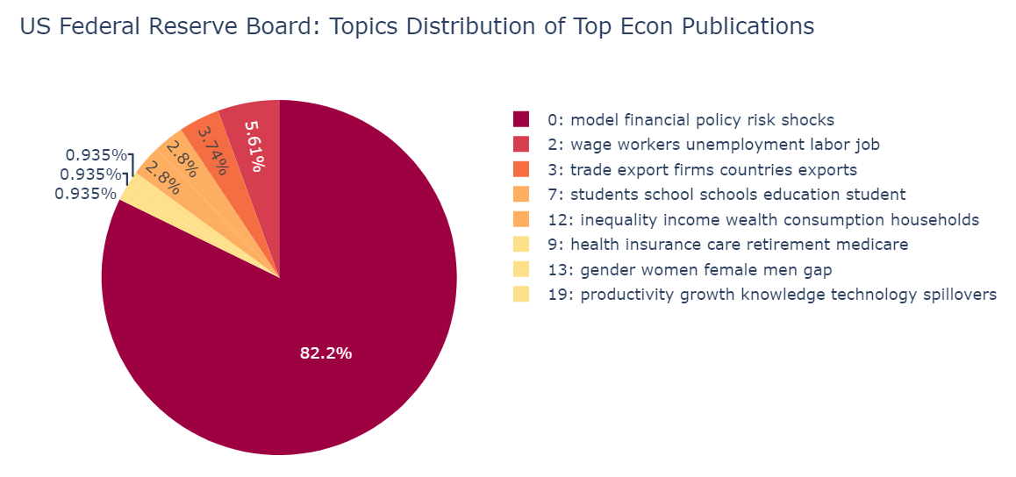
Topic Modeling Analysis
Specialization Areas of Different Institutions
UChicago has a much broader interests of topics, almost covering all 22 topics we identify!
Every document is assigned with a single MOST RELEVANT topic.
We can use this result to see what topics an institution is focusing on.
FED is mostly researching about “financial policy, risk, shocks”, macro related topics. Make sense!

Slide 27
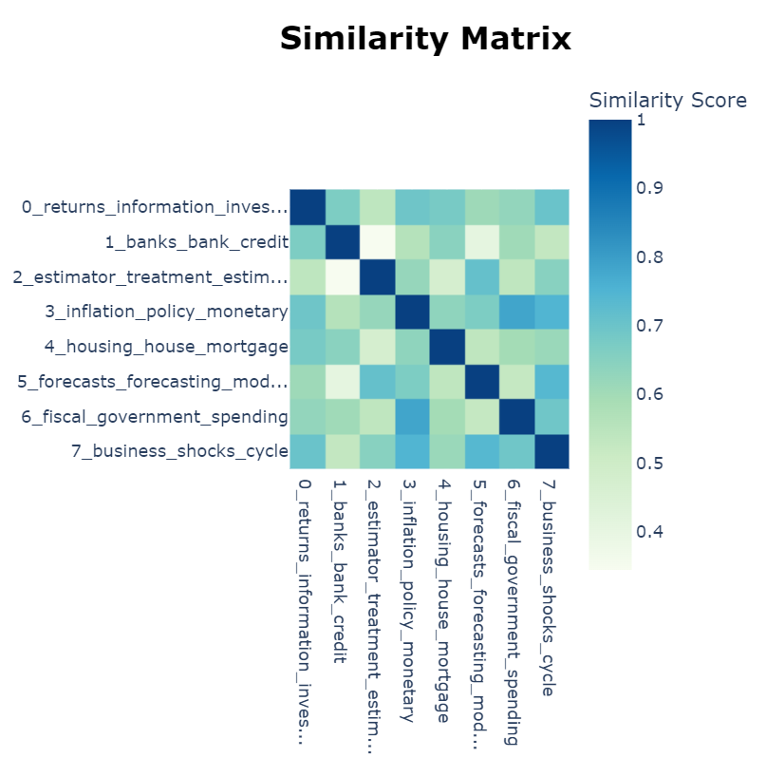
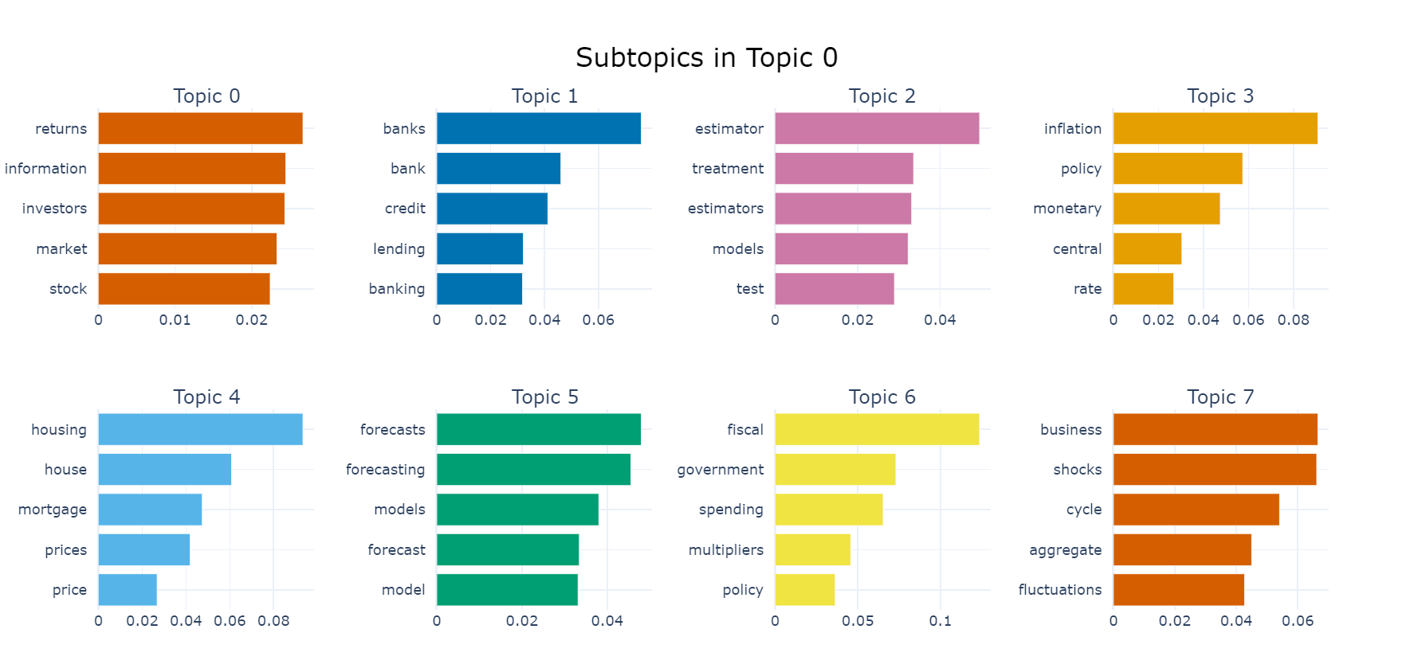
Topic Modeling Analysis
Though similarity scores are relatively high compared with the previous whole model, these subtopics do make sense and form separate economic fields.
Further Decomposition of Dominating Topic 0
Topic 0: model, financial, policy, risk, shocks, …
Occupy 5,000+ abstracts, need further splitting …
We re-run a TM on abstracts that belong to Topic 0.
Show the results of Top 8 subtopics:

Slide 28
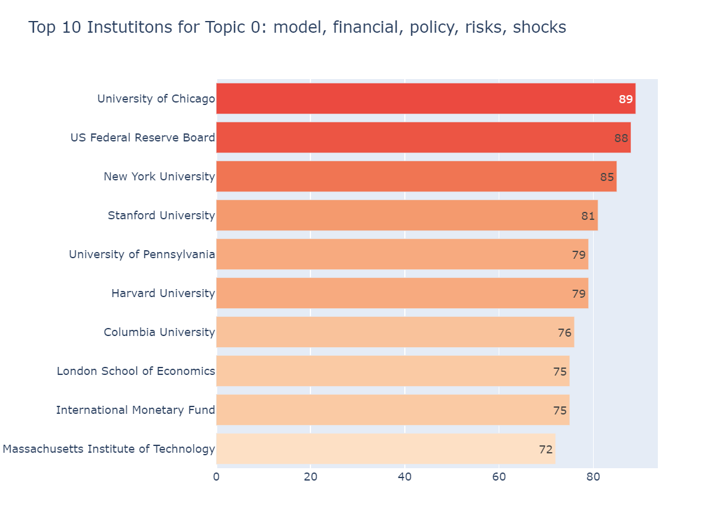
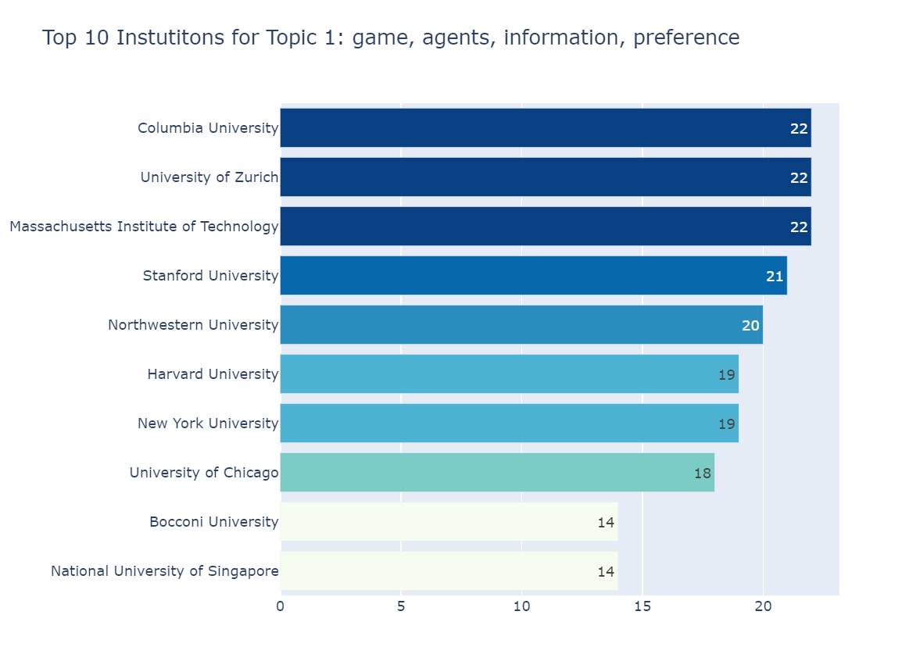
Topic Modeling Analysis
Top Institutions by Top 5 Research Topics:

Slide 29
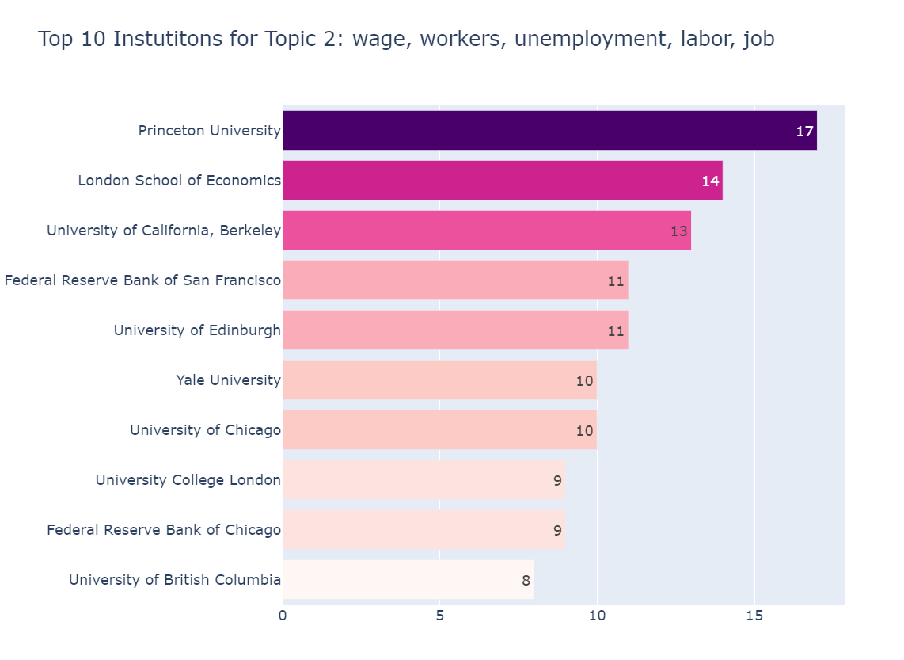
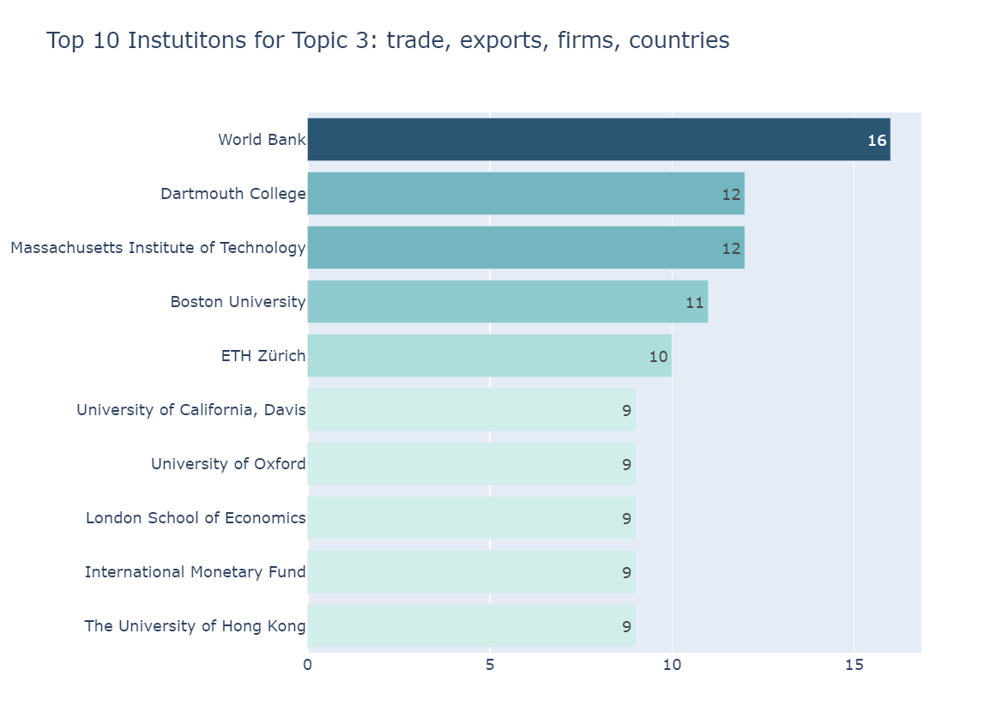
Topic Modeling Analysis
Top Institutions by Top 5 Research Topics:

Slide 30
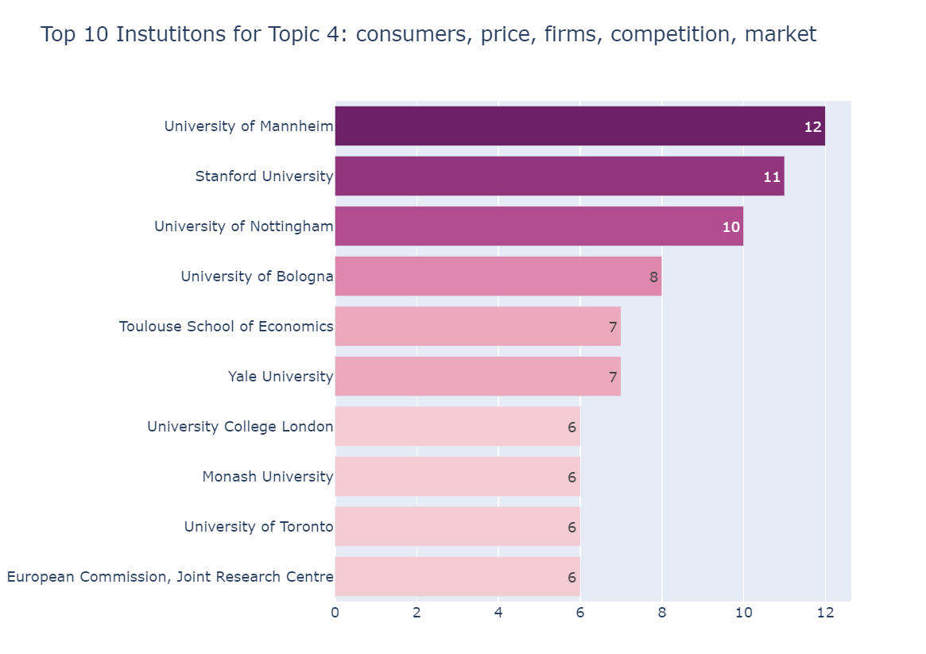
Topic Modeling Analysis
Top Institutions by Top 5 Research Topics:

Slide 31
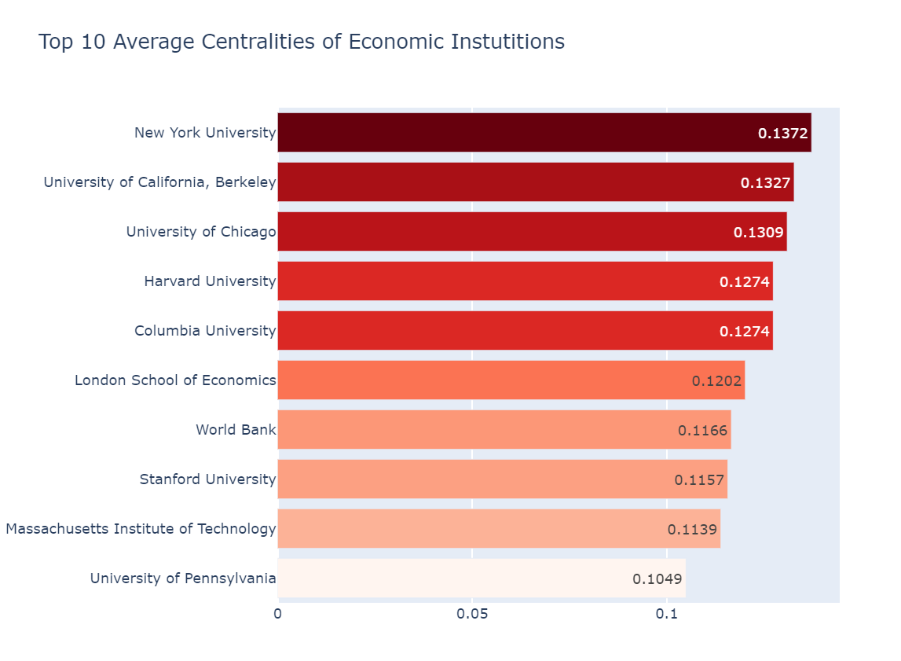
Do Centralities Research the Same Topics?
Combining SNA and TM …… First Recall the Top 10 Centralities:

Slide 32
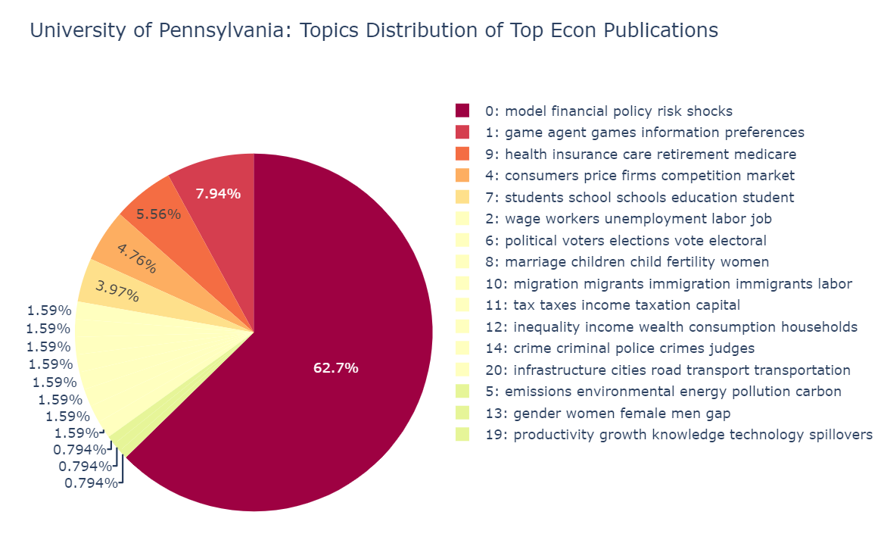
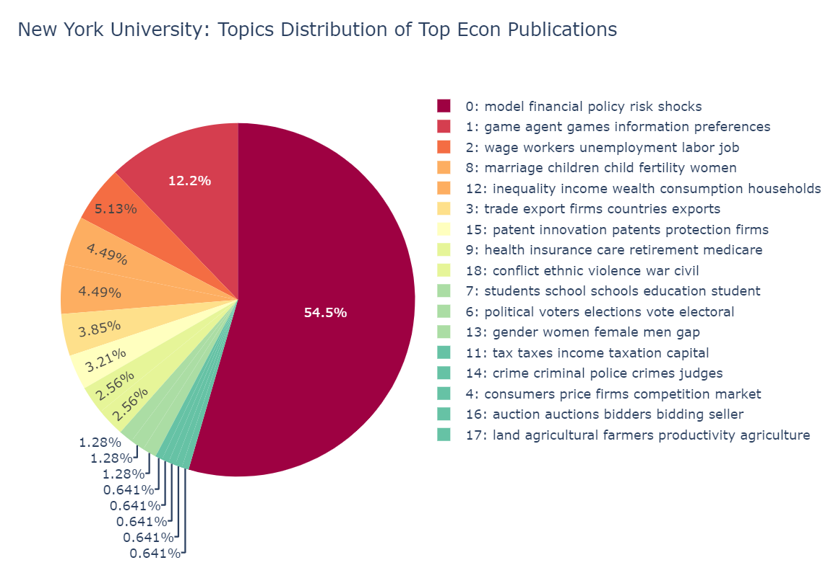
Do Centralities Research the Same Topics?
Combining SNA and TM …… Show Centralities’ Topics Distributions:
Some are mainly focusing on the Topic 0 about Financial Policy, Risks, and Shocks (50%+ of publications are about Topic 0)
e.g., LSE, NYU, UPenn, ColumbiaU

Slide 33
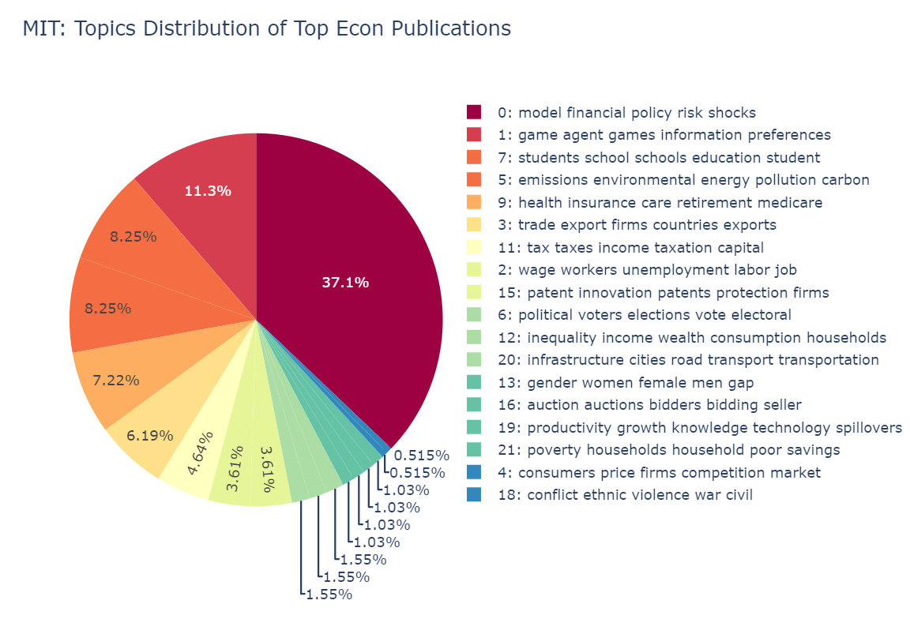
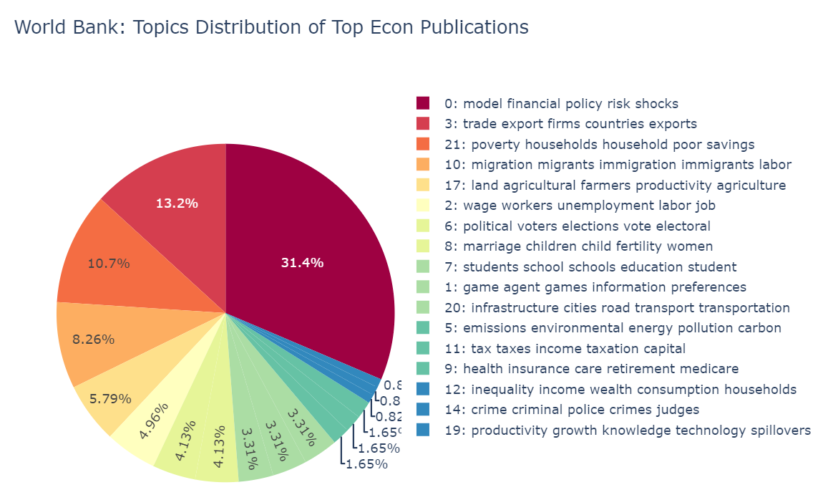
Do Centralities Research the Same Topics?
Combining SNA and TM …… Show Centralities’ Topics Distributions:
Others have more balanced distribution of topics.
e.g., MIT, UCB, Harvard, UChicago, Stanford, World Bank

Slide 34
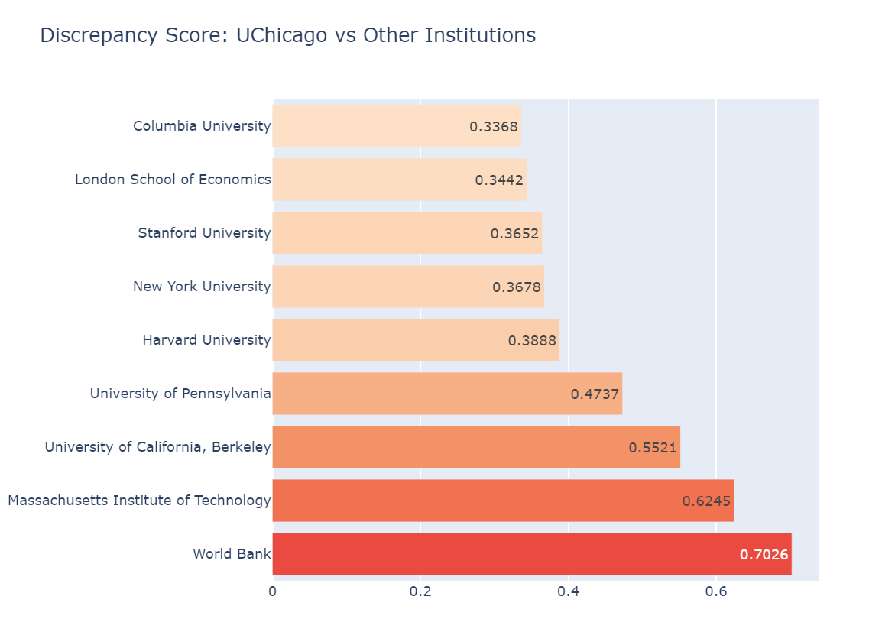
n
Do Centralities Research the Same Topics?
Combining SNA and TM …… Discrepancy Score between 2 Institutions’ Topics:
We want to measure the (dis)similarity levels of research topics among central institutions.
Specifically, we would like to see the discrepancy in proportions of research topics. The higher discrepancy is, the less similar two centralities’ research topics are.
Suppose we have 2 institutions A and B, with n attributes Xij.
n is the number of possible topics which is 22 in our case.
i denotes institution i, and j denotes Topic j.
Each attribute is the proportion of a certain Topic j among all.
Discrepancy Score between A and B := sum of |XAj - XBj| over j
For example: UChicago vs Other Centralities
UChicago is very similar as ColumbiaU and LSE, but not so similar as MIT and World Bank.

Slide 35
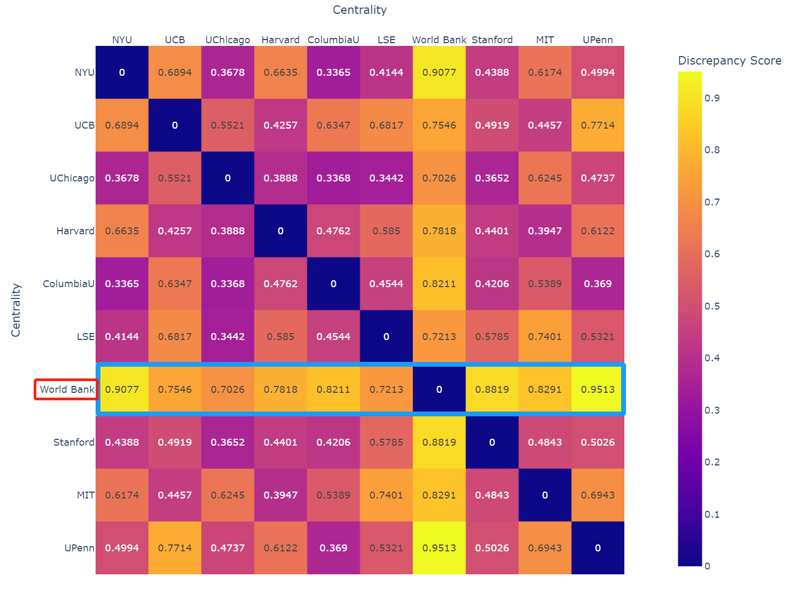
n
Do Centralities Research the Same Topics?
Combining SNA and TM …… Discrepancy Scores between 2 Institutions’ Topics:
World Bank has large discrepancy scores with other university-institutions! While among university-institutions, the discrepancy levels are relatively lower in general.

Slide 36
Take-home Points
From Technical Experience:
SQL is really convenient to structure datasets and extract relevant information!
Except for speed, Selenium is way better than Requests for web scraping!
Plotly is fantastic for fancier visualization and interactive plots!
When doing Topic Modeling, try out BERTopic package! Do NOT stick to Gensim LDA.
Social Science Significance:
We form a whole picture of the current Economic academia by 1): identifying its collaboration patterns on Top Econ Journals through network analysis 2): research topics evolvement across time and institutions through dynamic topic modeling.
From SNA, Top tier institutions are more likely to collaborate with institutions of similar levels; but for lower tier institutions, they often collaborate with those from very different tiers. In other words, an institution’s cross-rank/tier collaboration likelihood decreases as its tier/rank gets higher.
From TM, we see topics are stable in trends across time with some fluctuations but can vary a lot across different institutions.
From both SNA and TM, we find centralities of university-institutions are relatively similar in what they research, but World Bank shows a large discrepancy against university-institutions.

Slide 37
This is the end of Presentation.
Thanks for Listening!
Q & A

